Slide 1
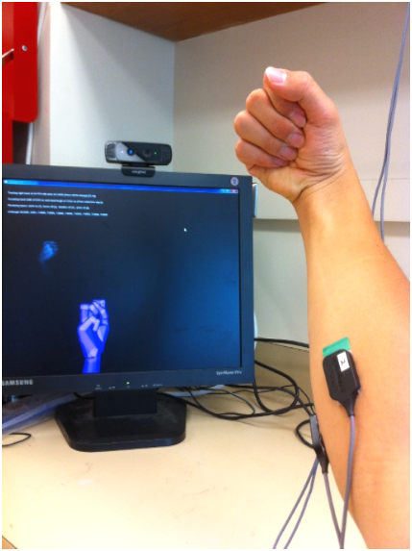
Intel supports multimodal interactivity with devices
SWOT recommended:
closer industry ties as collaborations
connect to consumer base with technologies that also benefit the main testbeds
Following a graduated testbed: “neurogaming”
50 K Intel grant to the CSNE
Draw on inherent idea of multimodality in neural systems
A future focus on sparse (compressed) sensing

Slide 2
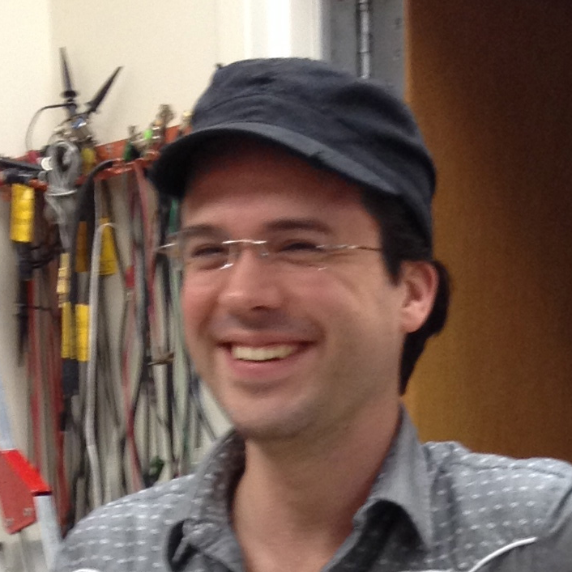
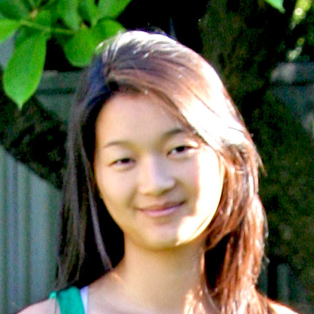

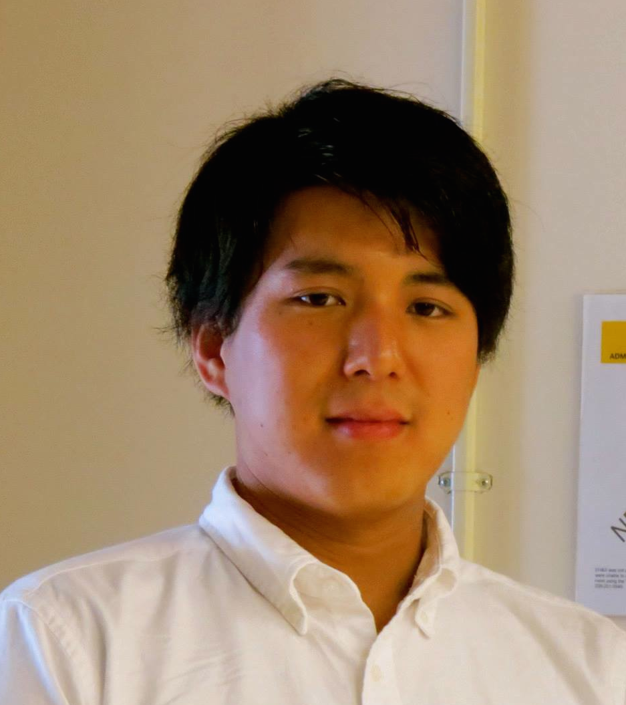
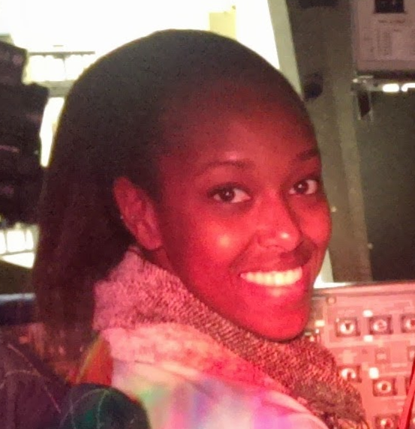
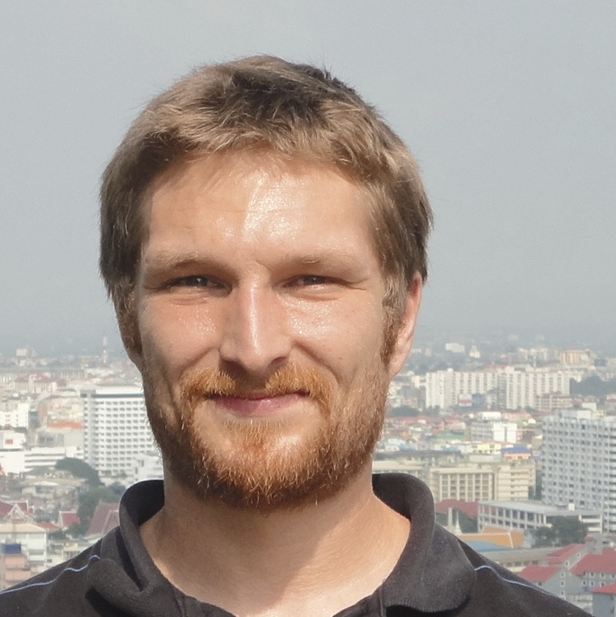
The Team
Eric Rombokas
Bing Brunton
Camilo Tejeiro Junki Nakagawa Kit Githinji Justin Thompson

Slide 3
Multimodal Opportunity
Junki Nakagawa (U. Tokyo)

Slide 4
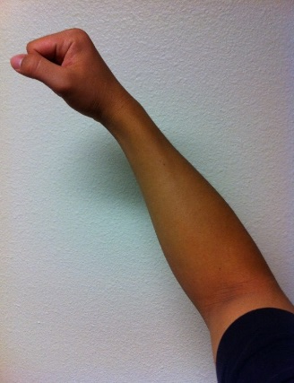
EMG Calibration
Measured
EMG data
normalization
EMG signals
application
EMG sensors
MVC (Maximum Voluntary Contraction)
- user flexes to “maximum”
- used as a scalar normalizing constant for EMG signals

Slide 5
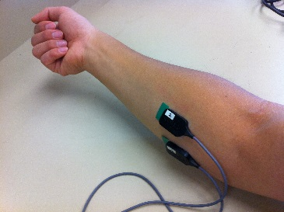
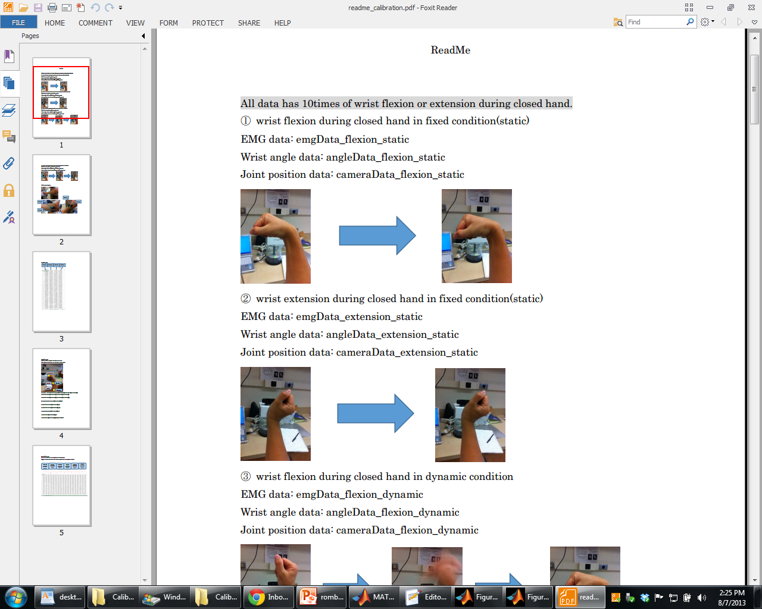
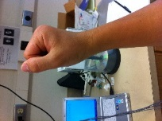
EMG Calibration
MVC is highly dependent on pose
MVC for each wrist angle (time-varying EMG recording)
1.4
1.2
Flexor
1
0.8
EMG voltage
0.6
0.4
0.2
0
90Degrees
45Degrees
0Degrees
-25Degrees
-50Degrees
Wrist angle

Slide 6
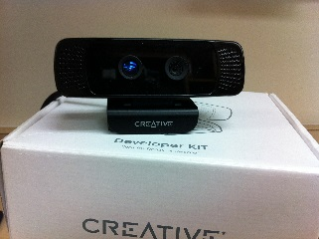

EMG Calibration
Measured
EMG data
normalization
EMG signals
application
EMG sensors
90Degrees
45Degrees
0Degrees
-25Degrees
-50Degrees
Intel Camera

Slide 7
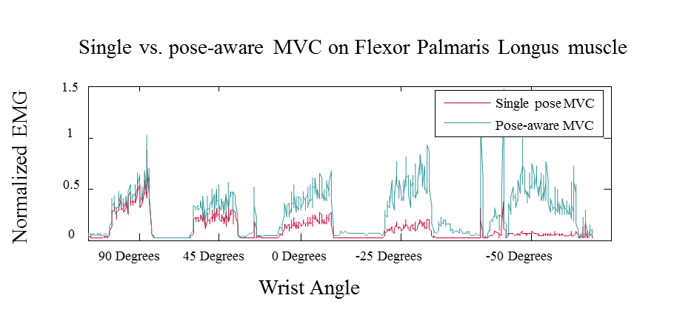
Multimodal Opportunity
Perfect normalization: recordings would be equal for every pose.
Using “pose-aware” MVC, recordings (blue) are more equal

Slide 8
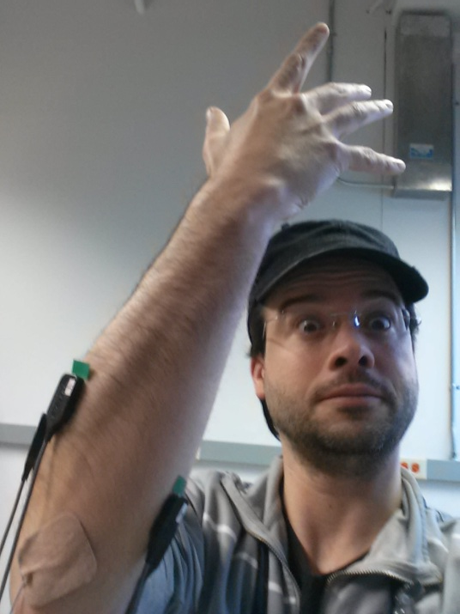
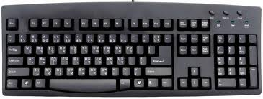
Myometric Authentication
Secret Password
********
Secret Pass-Movement

Slide 9
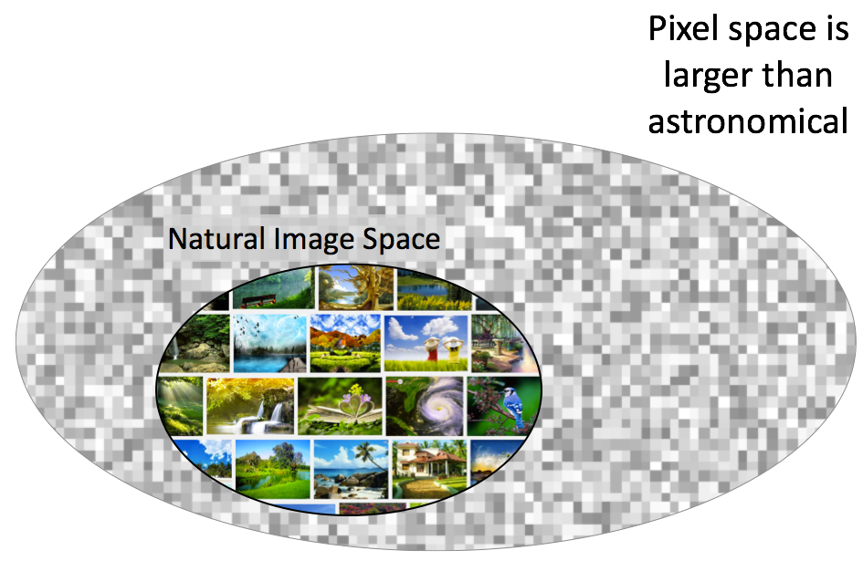
Patterns underlie natural signals

Slide 10
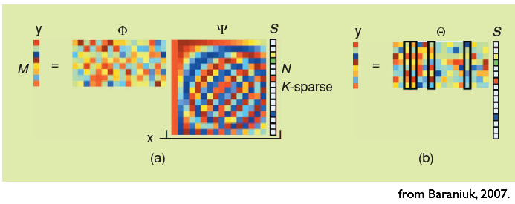
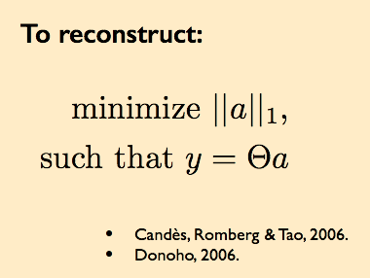
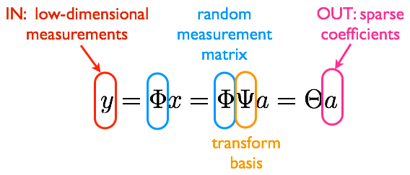
Compressive Sensing

Slide 11
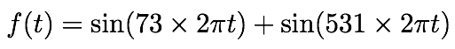
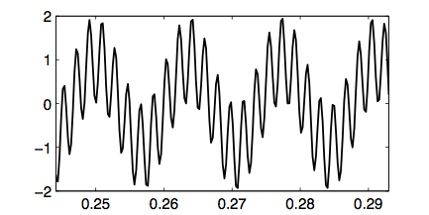
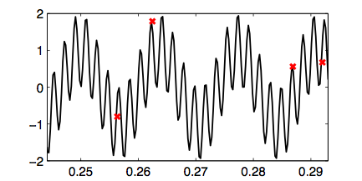
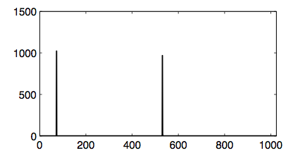
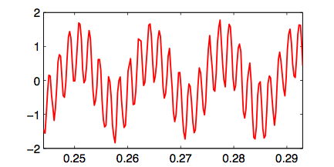
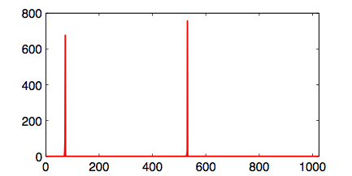
Beating Nyquist
Nyquist sampling: 1062 samples/sec
Compressive sampling: 128 samples/sec
f(t)
Power
Time
Frequency
f(t)
Power
Time
Frequency

Slide 12
High-dimensional, multi-modal, dynamic data
Justin Thompson
Research Experience for Veterans (REV) Scholar

Slide 13
Low-dimensional dynamic fingerprints
Frequency
Time
Sensors

